Slide 1
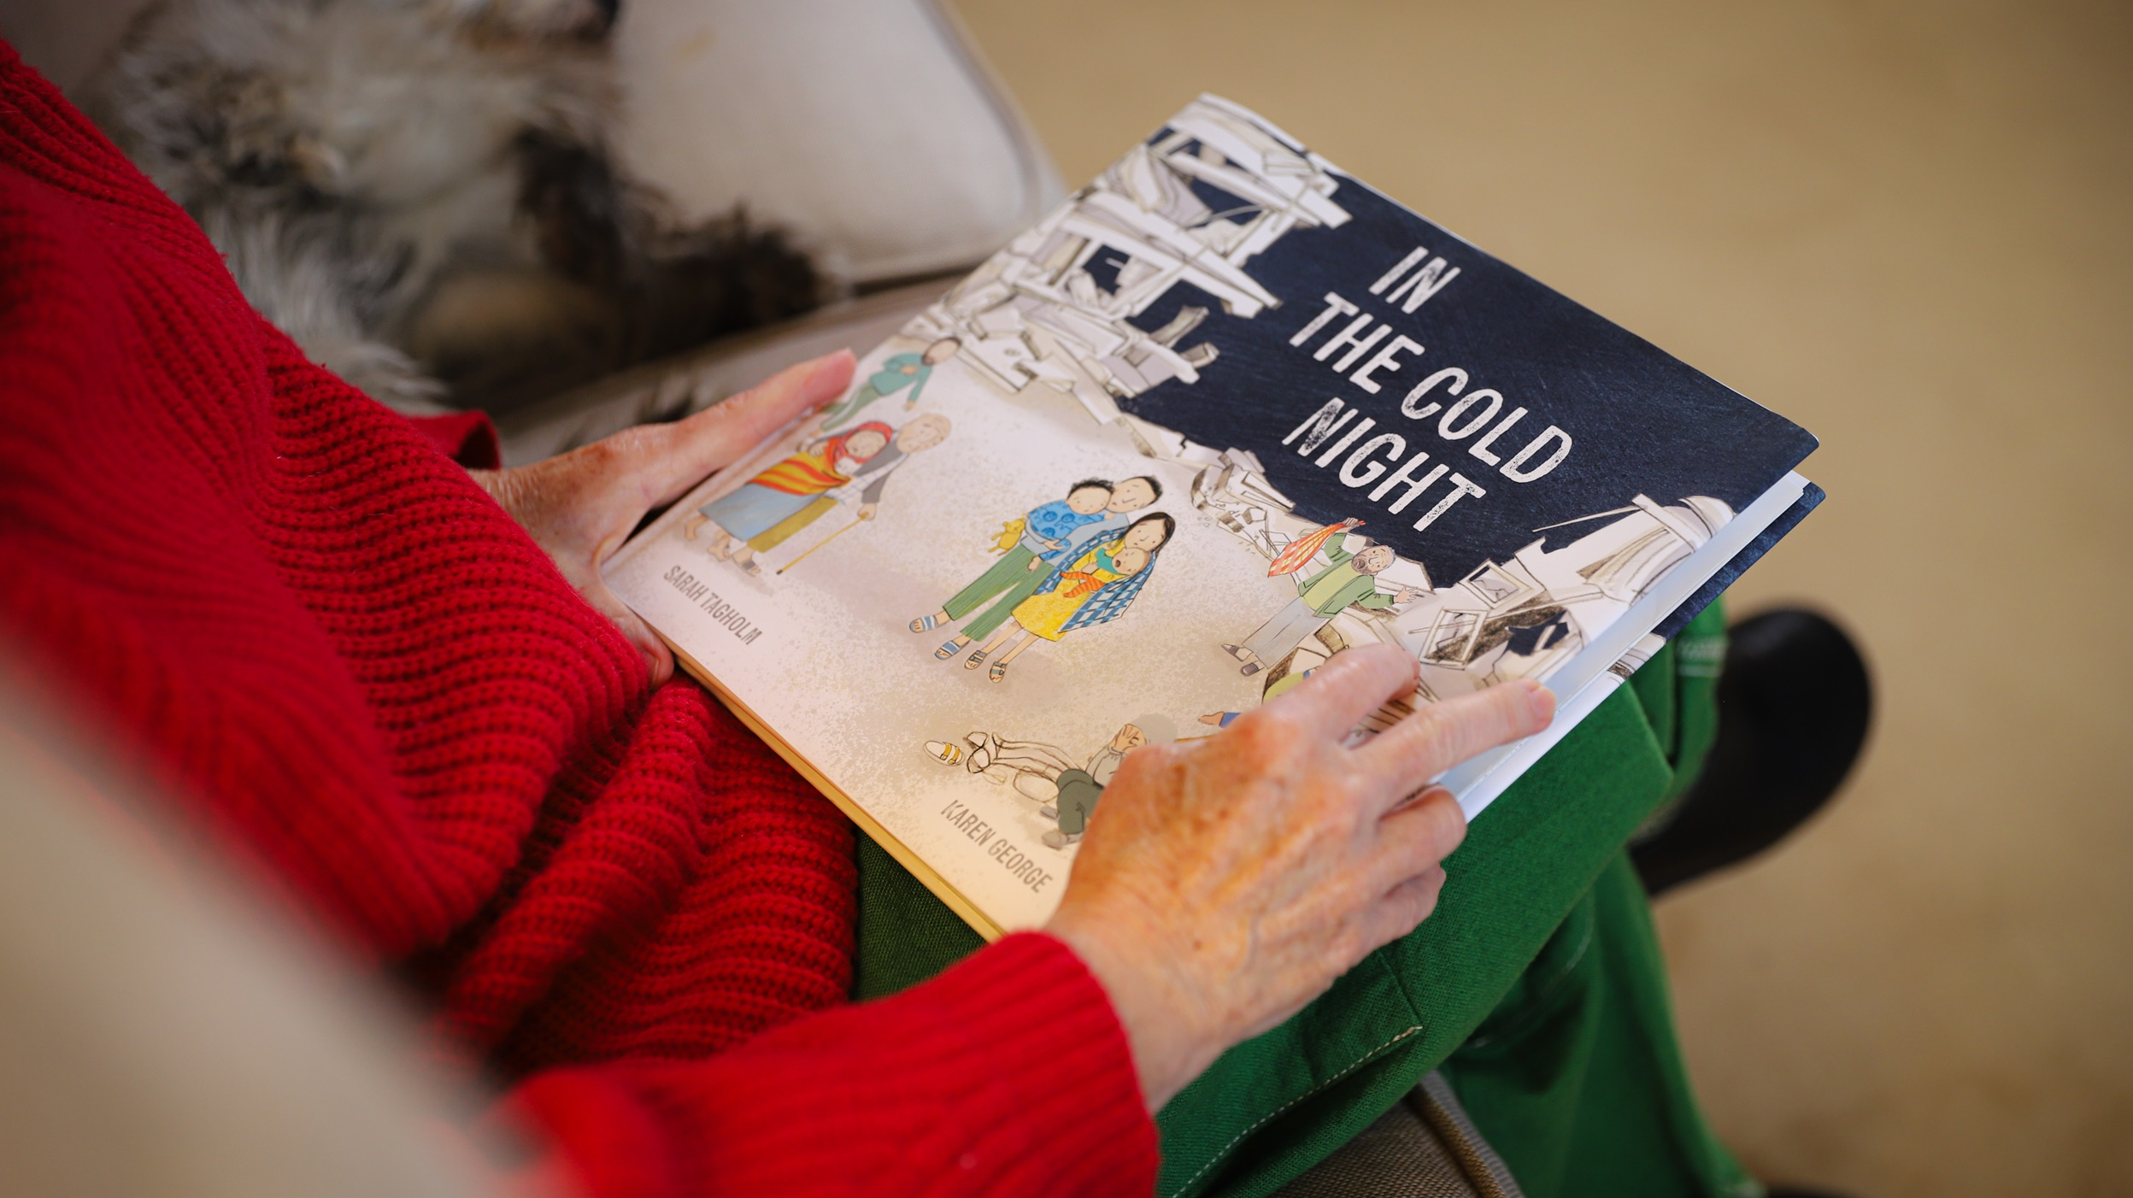
Notes:
This story is called IN THE COLD NIGHT.

Slide 2
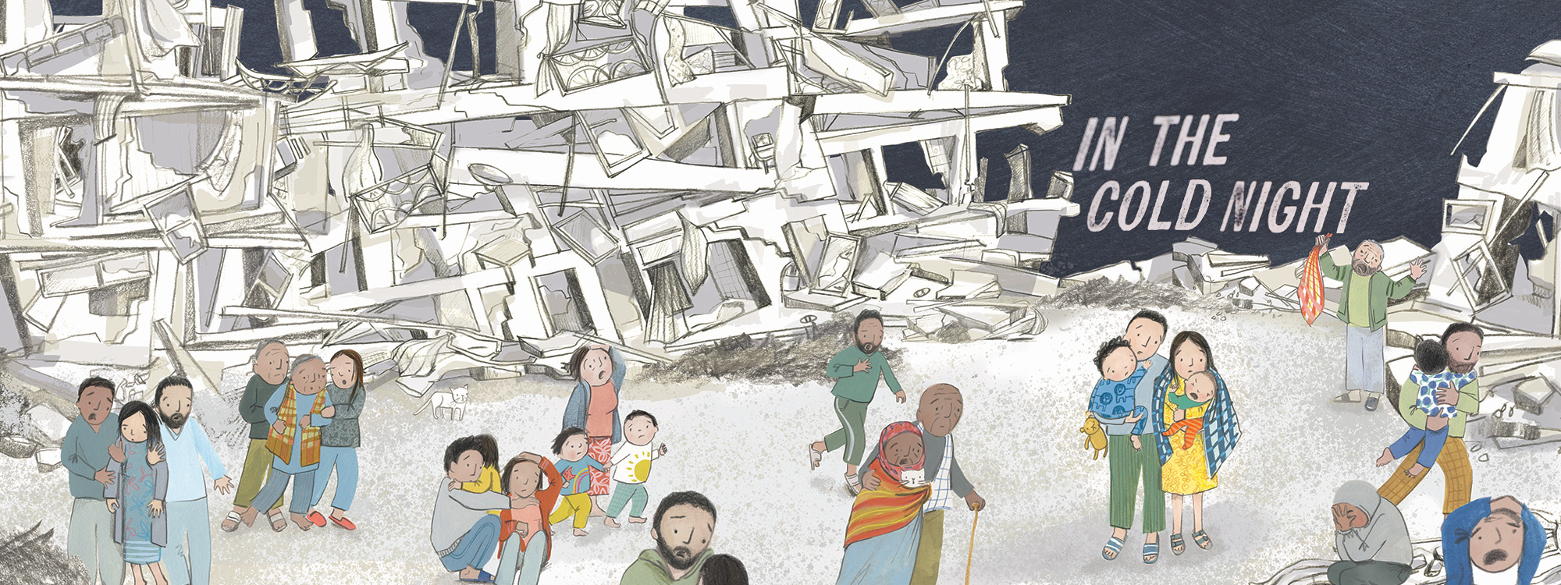
Notes:
It is written by ShelterBox staff member Sarah Tagholm with illustrations by Karen George.

Slide 3
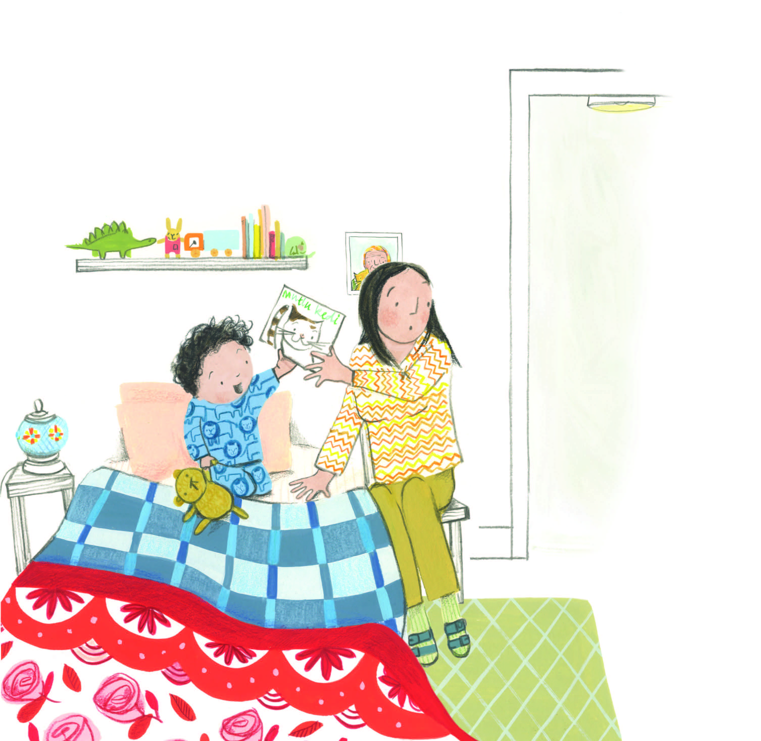
Notes:
At bedtime I said: “Please Mama, can i have the cat story?“.
But then the baby started crying. Waa, waa, waa!
Mother says we have to call the baby Fatima. But I never wanted a new person. Especially not an always crying one.

Slide 4
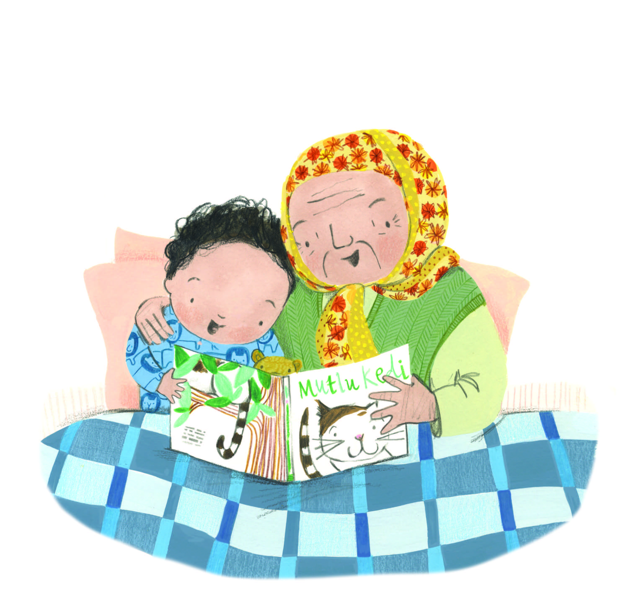
Notes:
So, my Nana read to me until I fell asleep… Zzzzzzzzz

Slide 5
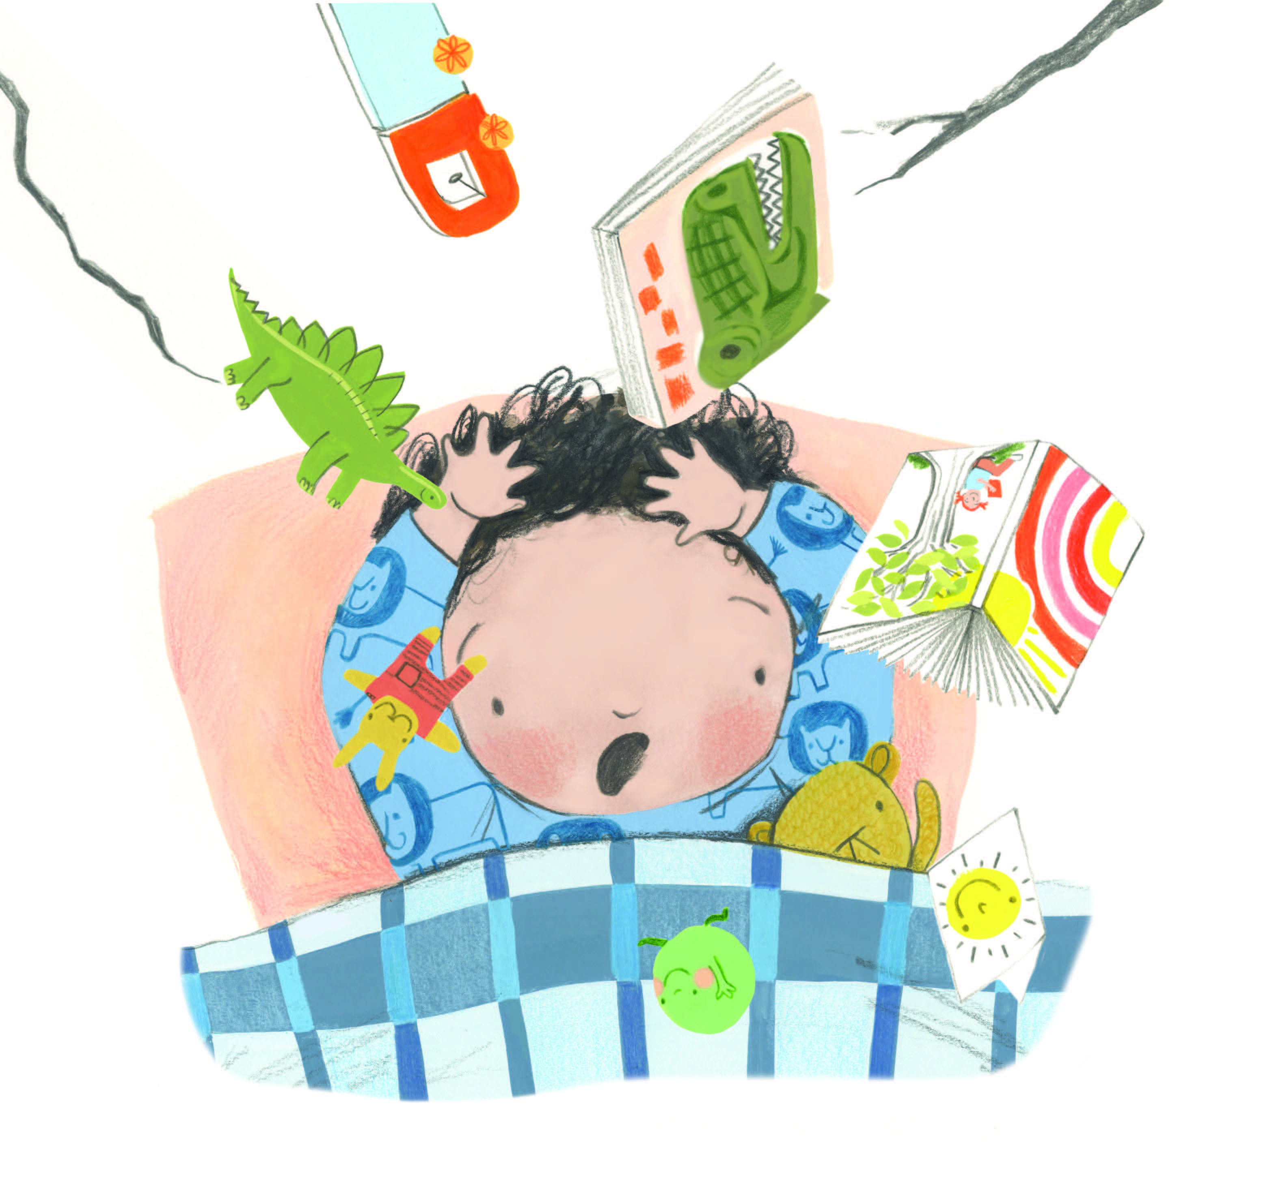
Notes:
But then... I heard screaming and crashing. My bed was shaking, and the walls were trembling and cracking.

Slide 6
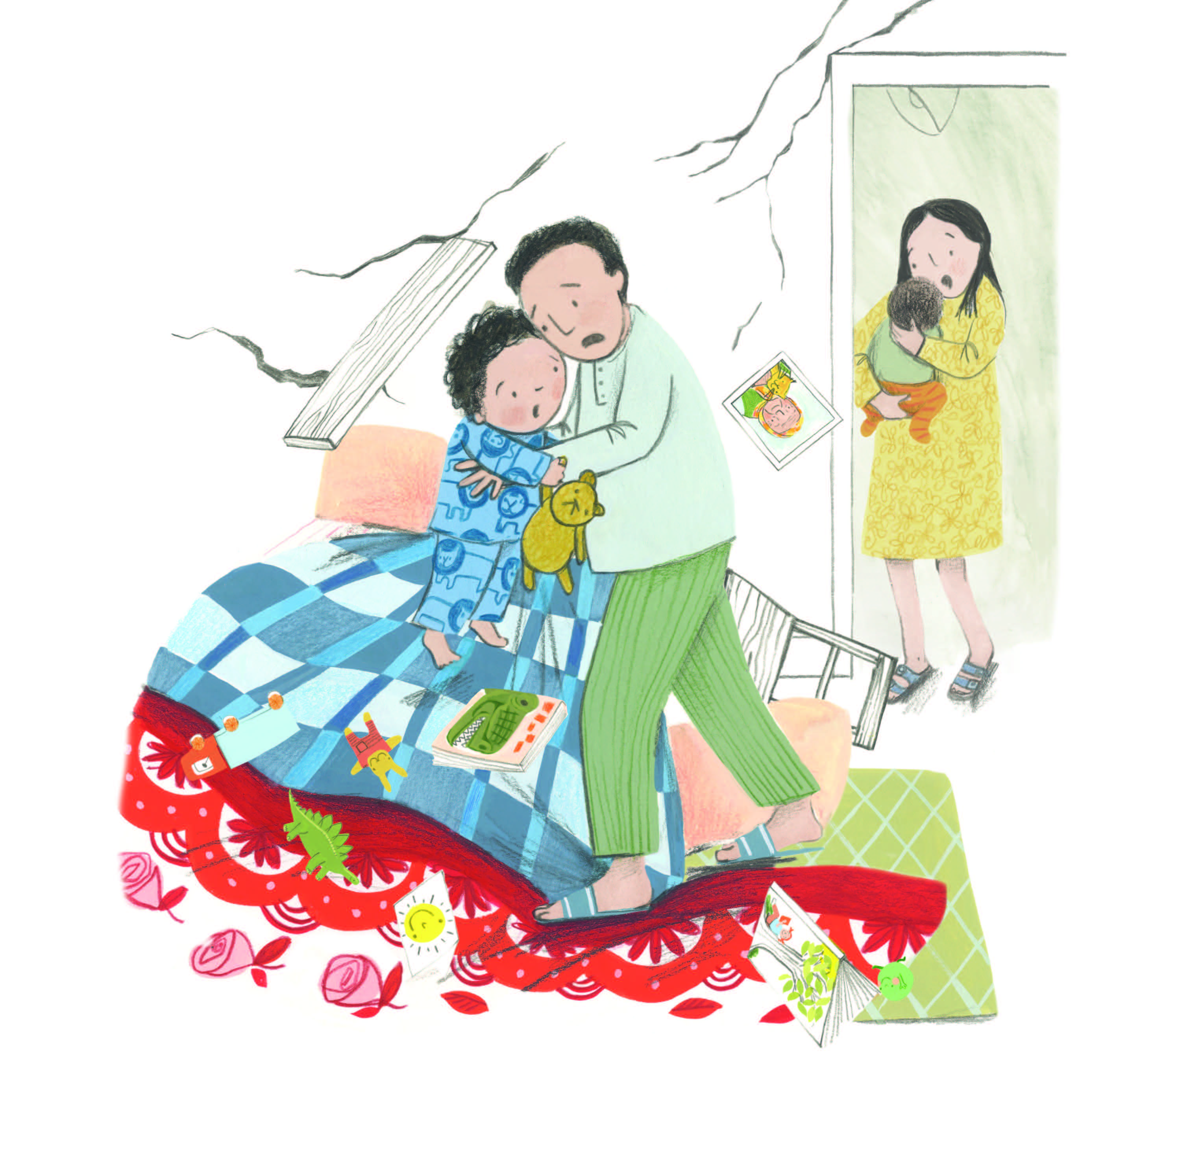
Notes:
Daddy grabbed me and I said "Where's the baby?" and Mama had her in her arms.
The buildings were falling down, so we ran outside.

Slide 7
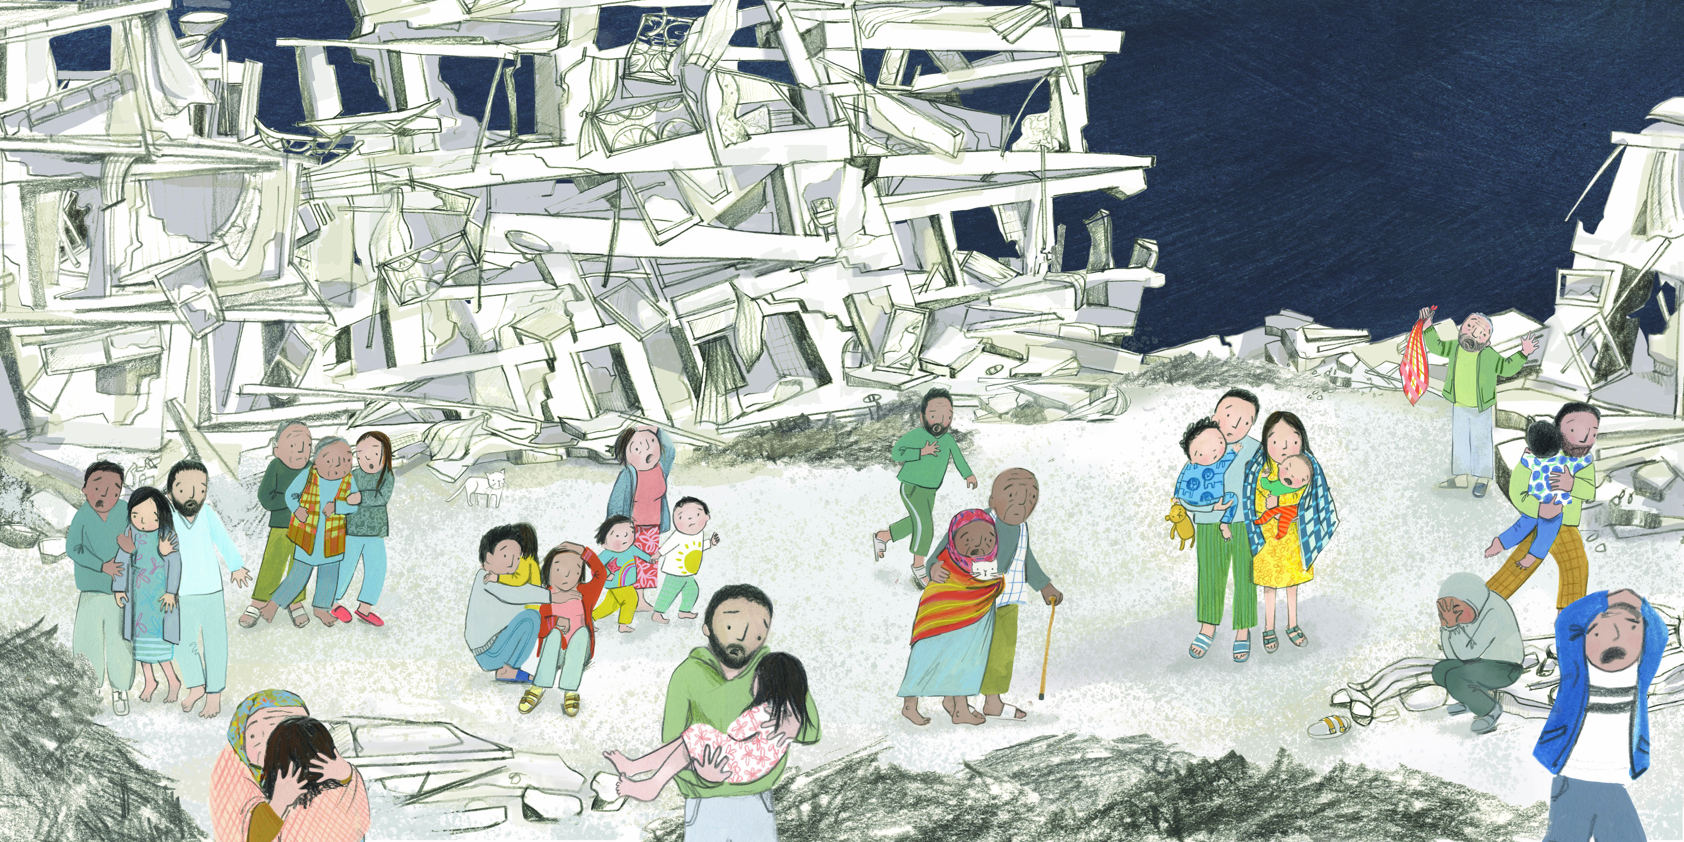
Notes:
Our neighbours and friends were running too, and everybody was shouting and crying.
Then we were in the cold night wearing just our bedtime clothes and we didn't know where was my Nana?

Slide 8
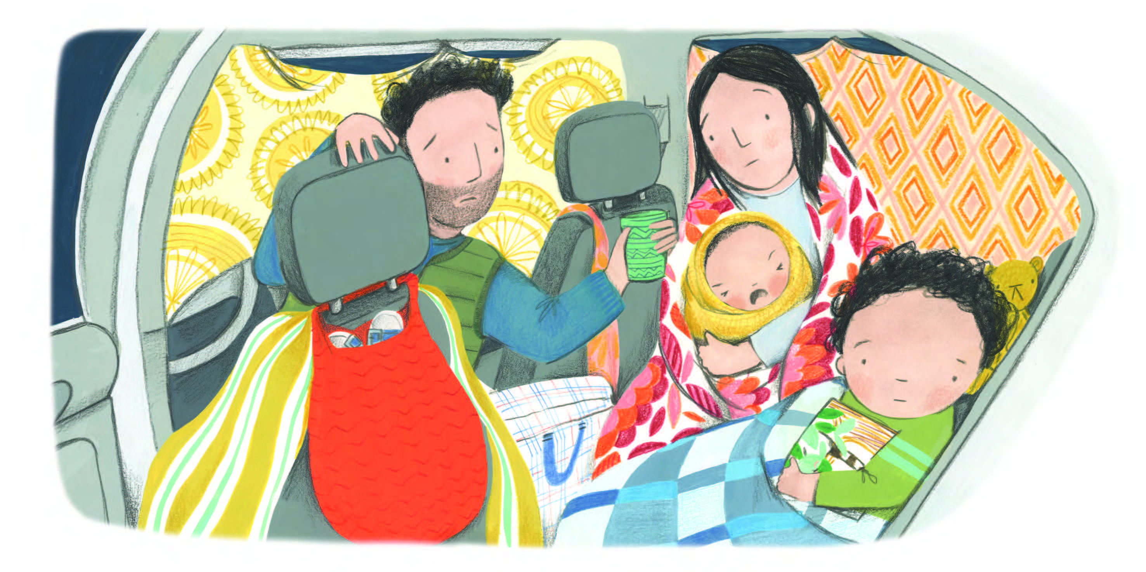
Notes:
The shaking earth broke our home, so we were always being in the car. You can't have bedtime stories in the car because it is too dark.
I miss my stories. I miss my bed. I miss my Nana.

Slide 9
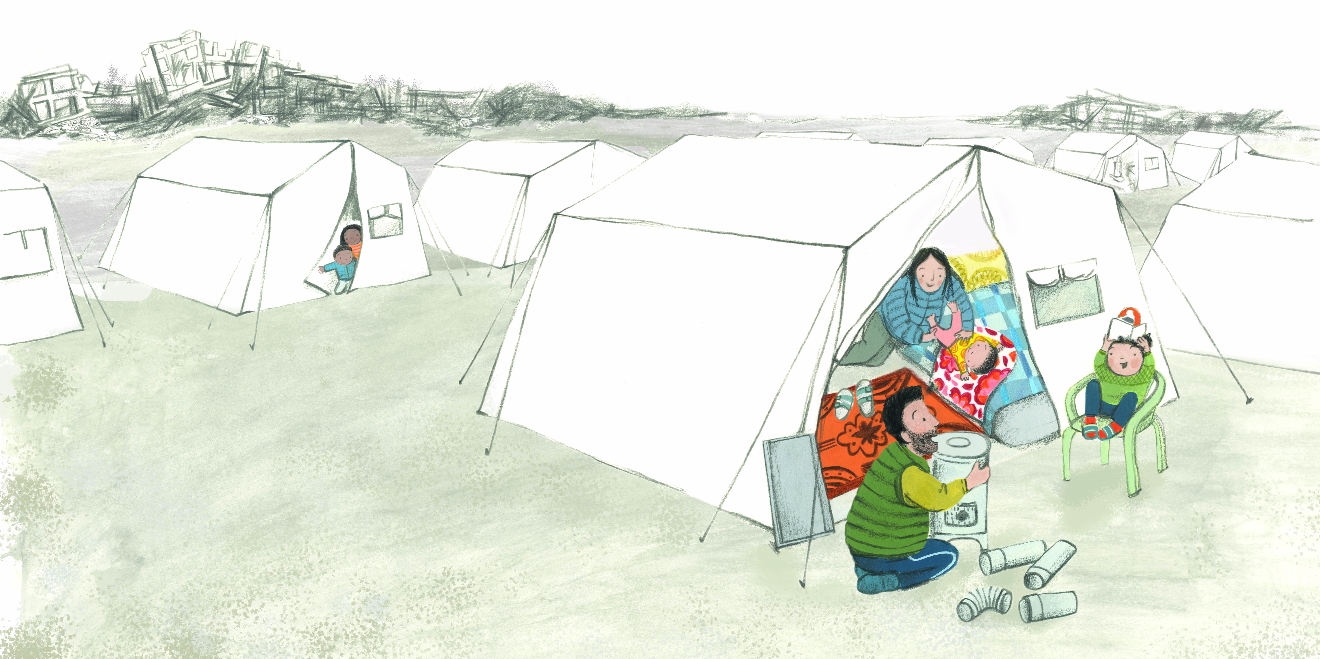
Notes:
Then some people gave us blankets and solar lights and a small house called a tent. And tent walls don't break even if the earth shakes.
It is all warm and we can stay here until we have a new home to go to.

Slide 10
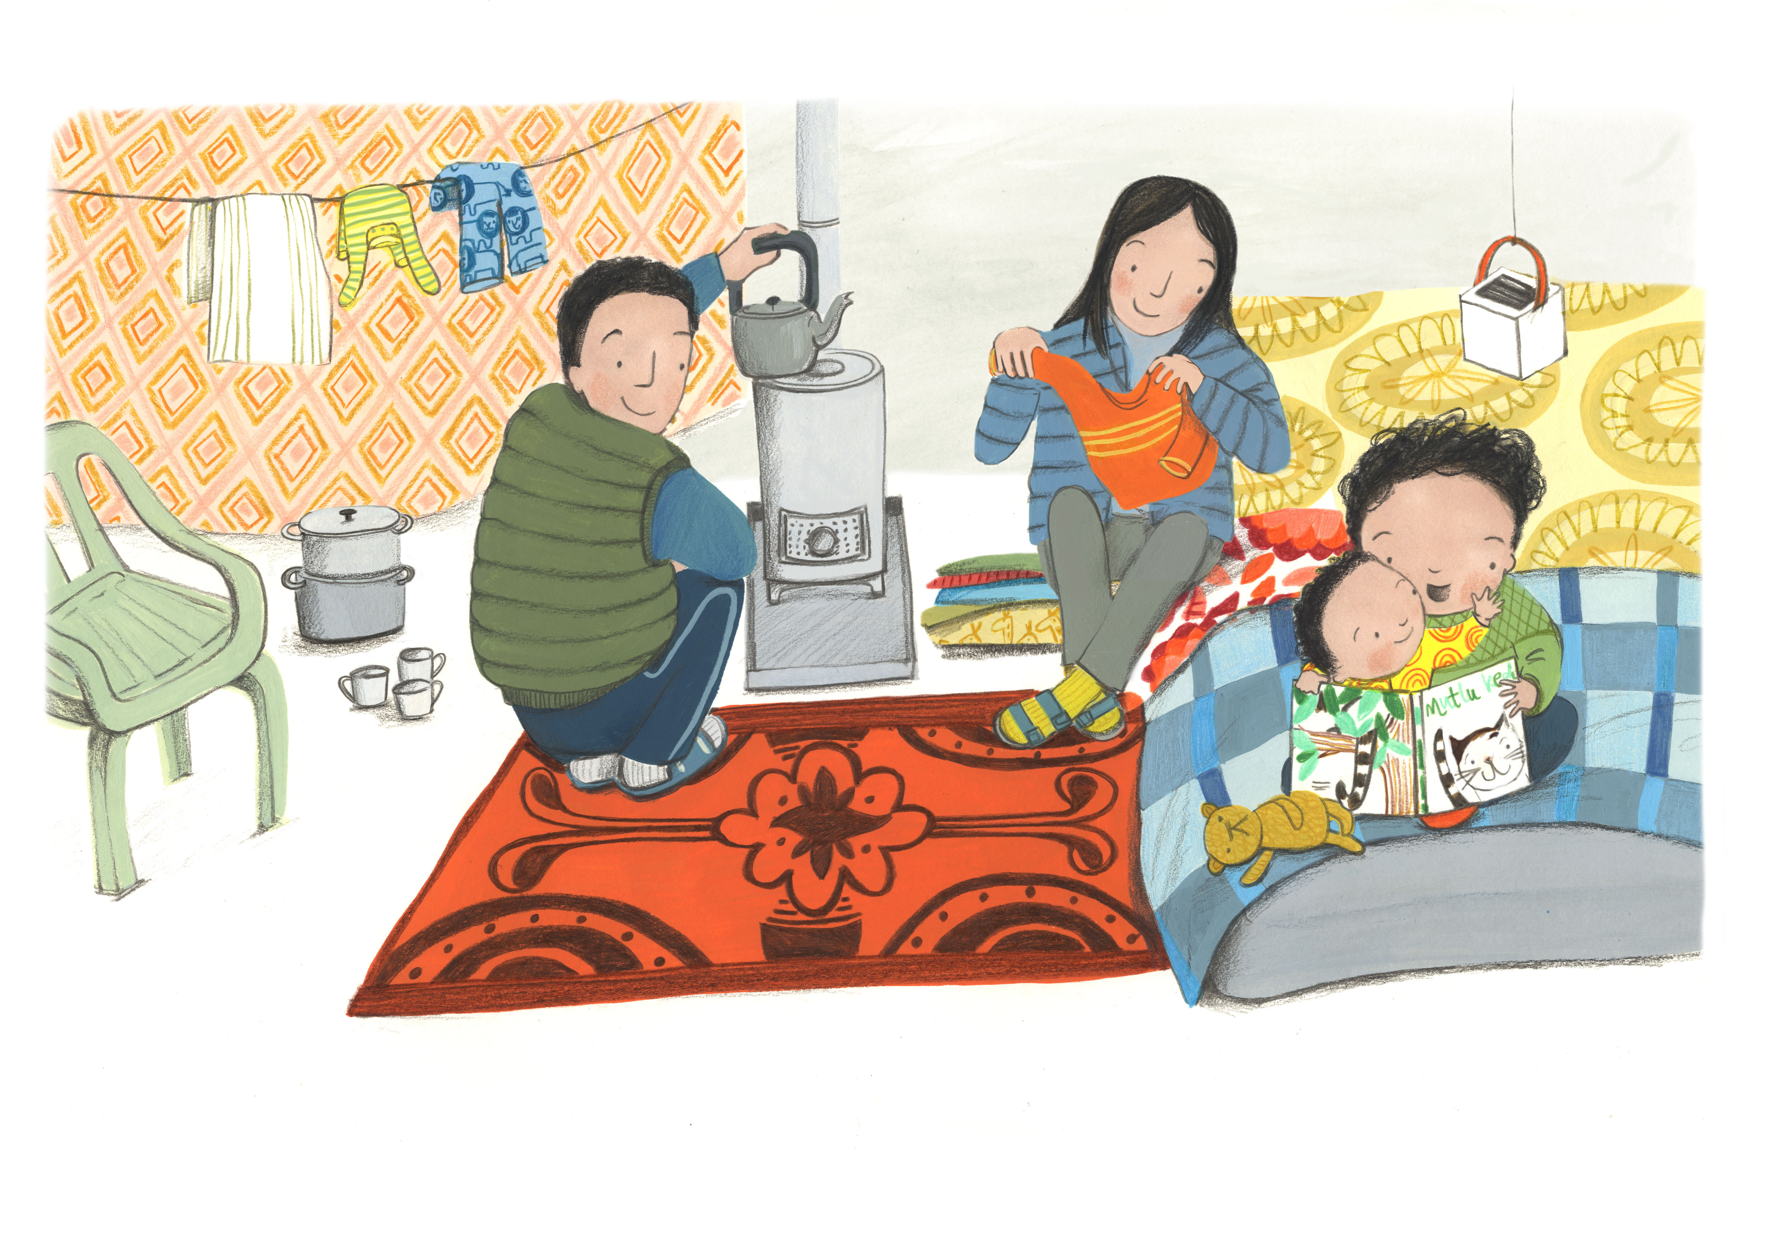
Notes:
Mother and Daddy are busy and I am the big brother. So, now I read the stories and I say: "Fatima, would you like the cat story?".

Slide 11
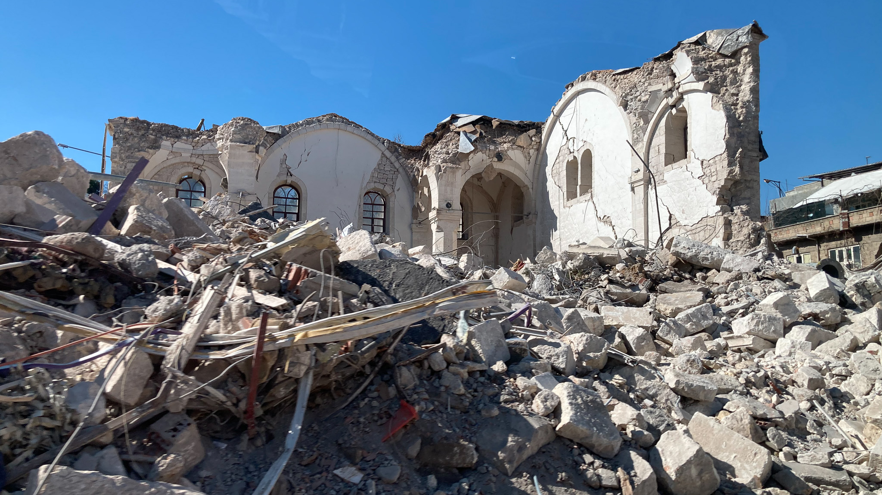
Notes:
Thank you for listening. That story was based on the real stories of families affected by the terrible earthquakes in Türkiye and Syria in February 2023. Thanks to our supporters / supporters like you we were able to help more than 12,500 people in Türkiye and Syria. Our aid package included shelter and other essential items such as blankets, mattresses, solar lights, and winter coats for children.

Slide 12
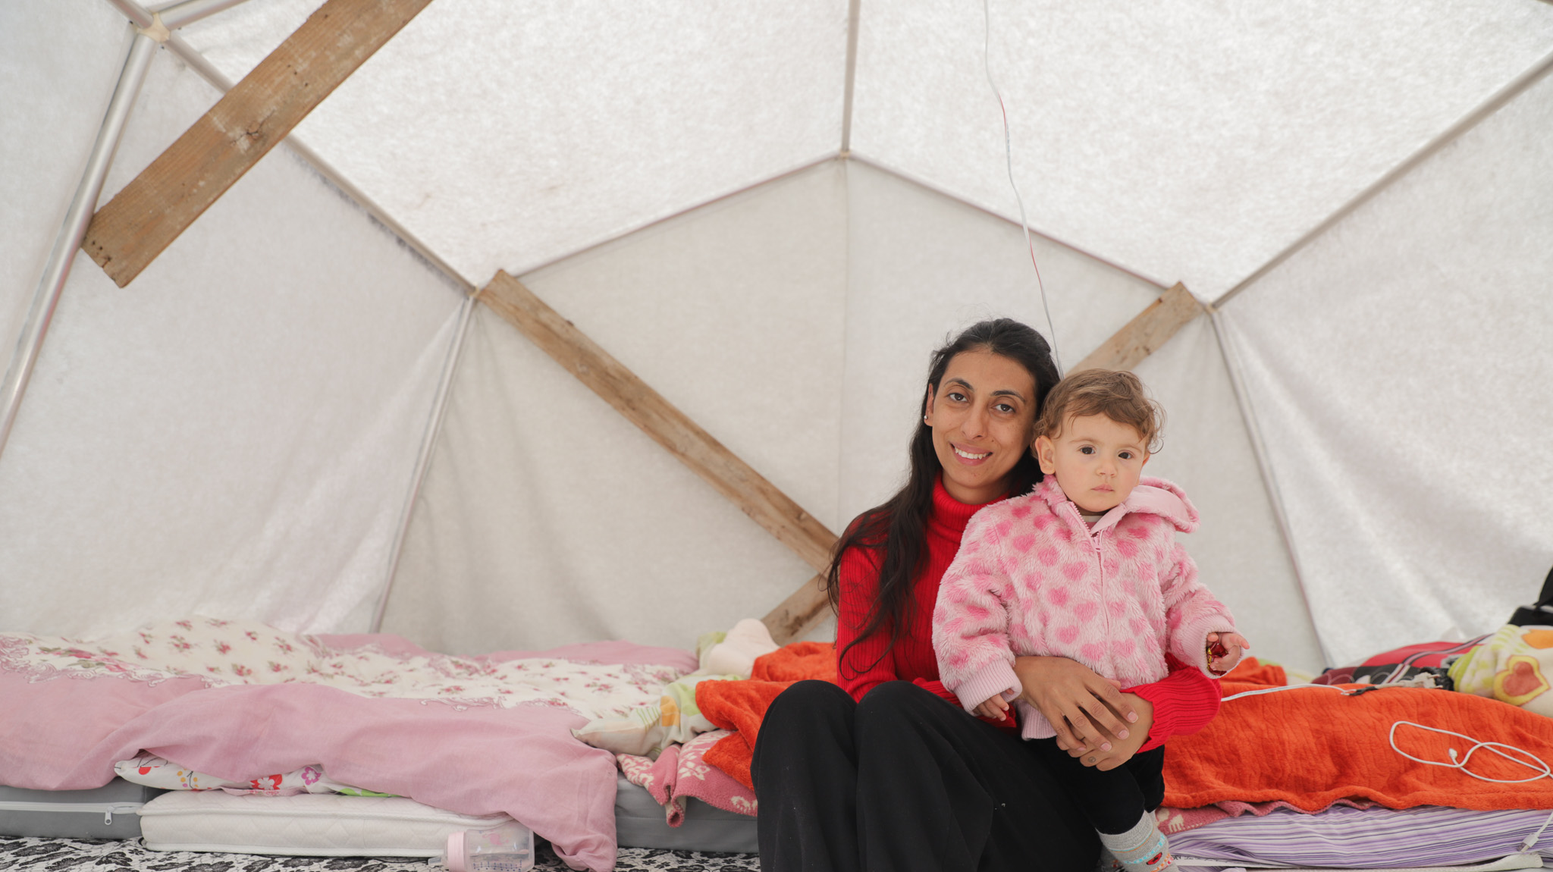
Notes:
People like 32 year-old Aleu and her young family in Türkiye. For Aleu, having a tent has relieved some of her fears: “If another big earthquake happens again, we will be relieved that we already have a tent to take shelter in.”

Slide 13
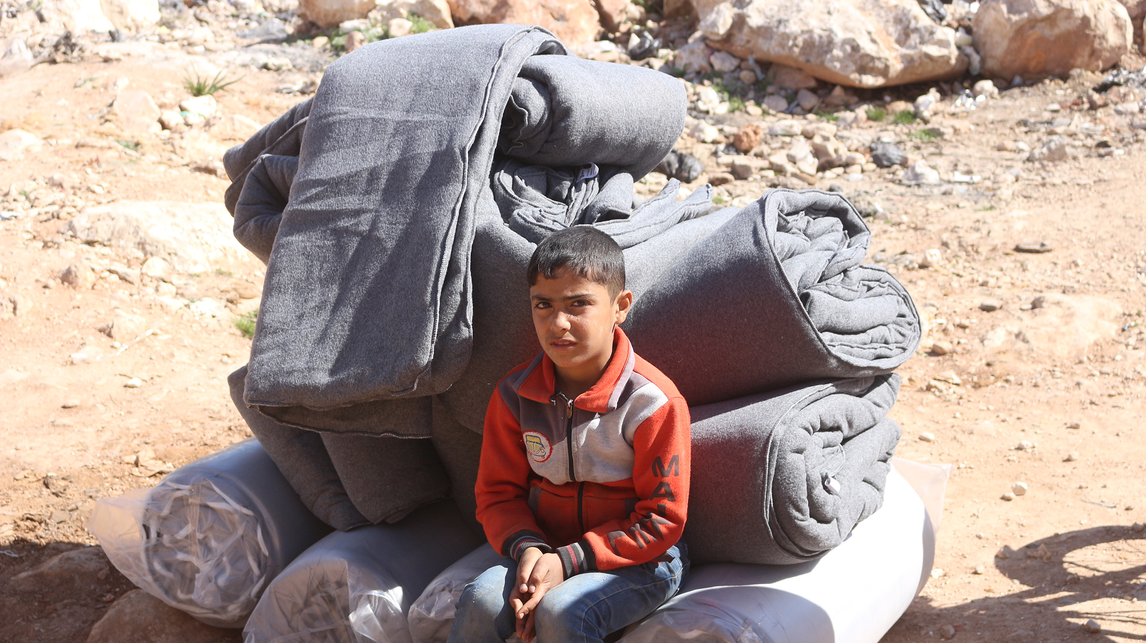
Notes:
This is 11 year-old Basel. We helped Basel and his family in Northern Syria. Basel’s mother said: “The earthquake was terrible and frightening. We got out of our homes that were damaged in the rain. The weather was cold. Now we live in a tent. Blankets and mattresses will help us to keep us warm and our children warm.”

Slide 14
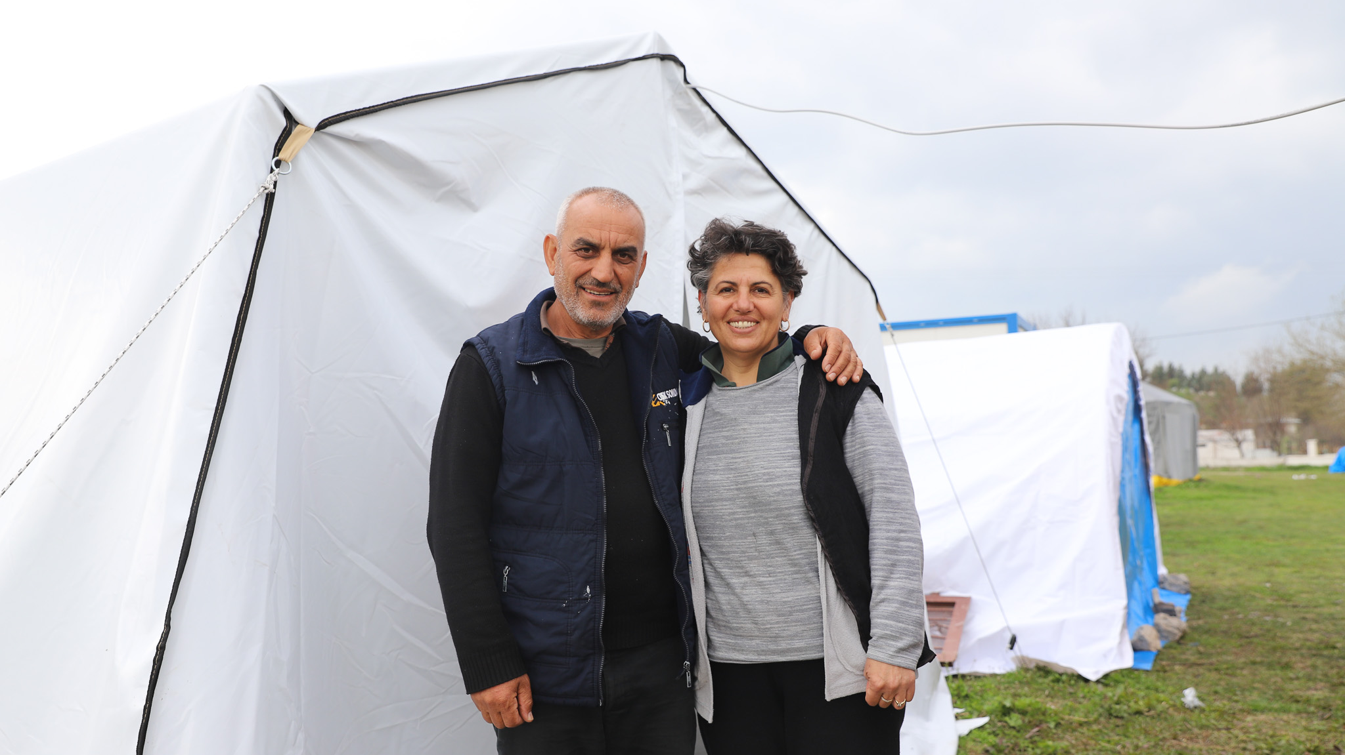
Notes:
And this is Nurgül and her husband in Türkiye. Nurgül said: “[The tent] is very beautiful. You put together a roof over our heads; you have provided us with shelter, the most fundamental thing. I thank you for making this our home.”

